Slide 1

Google Analytics Capstone Project
Presenter: Bing

Slide 2
Executive Summary
Company Overview:
In 2016, Cyclistic launched a successful bike-share offering. The bikes can be unlocked from one station and returned to any other station in the system anytime
Business Task
How do annual members and casual riders use Cyclistic bikes differently?
Recommendations:
Increase marketing campaigns in coastal areas and educate users on the use of bikes as an alternative mode of transport on weekdays

Slide 3
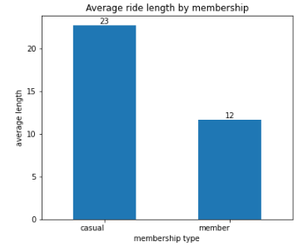
Ride Length by membership
Casual members ride on average 23 minutes
Annual members ride on average 12 minutes
Membership is not an indicator of longer ride time

Slide 4
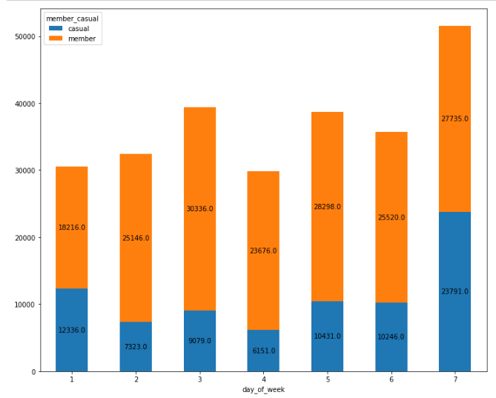
Ride Length by day of week
Casual members typically ride more on weekends
Annual members ride more consistently throughout the week

Slide 5
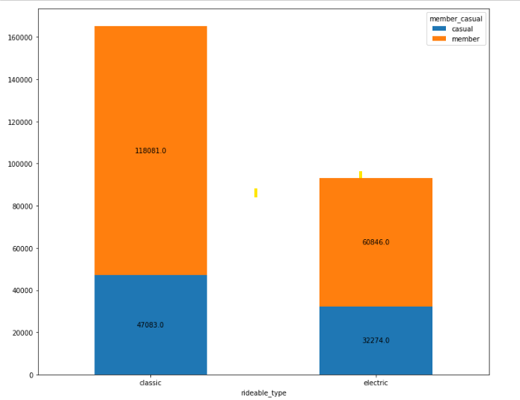
Types of bikes by membership
A large proportion of members prefer the use of classic bikes
Usage of both bike types are more evenly distributed amongst casual members

Slide 6
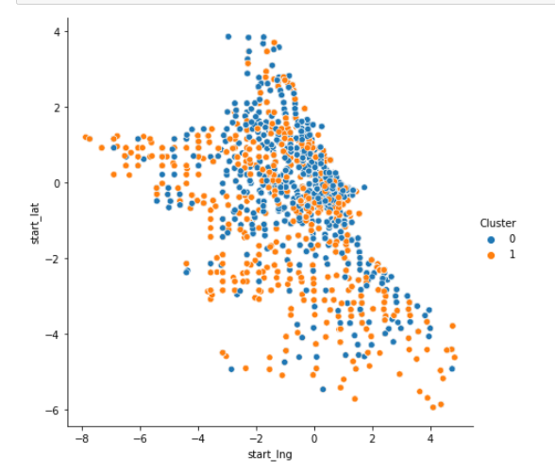
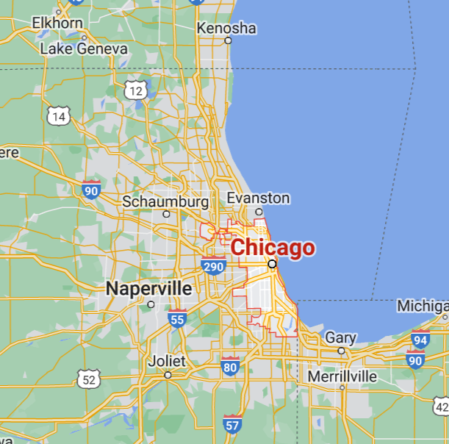
Membership by location
The scatterplot shows the geographic distribution of memberships in Chicago, IL
Members are more likely to be in inner suburbs while casual users are located along the coastal suburbs

Slide 7
Recommendations
Casual members tend to ride more on weekends and utilise the bikes longer per use. They are also more likely to use electric bikes.
The marketing team can run campaigns on the benefits of riding on weekdays as an alternative to user’s current mode of transport (i.e letting users trial annual membership)
The marketing team can also increase environmental awareness of the product to encourage more users to adopt bike sharing
Increase marketing campaigns near coastal suburbs to encourage users to convert as a member.

Slide 8
The End

